Slide 1
RUNGTA COLLEGE OF DENTAL SCIENCES & RESEARCH
TITLE OF THE TOPIC-
CLASSIFICATION OF MALOCLUSSION
DEPARTMENT OF ORTHODONTICS AND DENTOFACIAL ORTHOPAEDICS

Slide 2
Specific learning Objectives
CORE AREAS | DOMAIN | CATEGORY
TYPES OF MALOCLUSSION | AFFECTIVE | NICE TO KNOW
CLASSIFICATION | COGNITIVE | NICE TO KNOW
ANGLE’S CLASSIFICATION | COGNITIVE | MUST KNOW
SIMON’S CLASSIFICATION | COGNITIVE | MUST KNOW
ACKERMAN PROFFIT | COGNITIVE | MUST KNOW
INCISORS’ CLASSIFICATION | COGNITIVE | NICE TO KNOW

Slide 3
CONTENTS
INTRODUCTION
TYPES OF MALOCCLUSIONS
CLASSIFICATION OF MALOCCLUSION
ANGLE’S CLASSIFICATION OF MALOCCLUSION.
DRAWBACKS OF ANGLE’S CLASSIFICATION
DEWEY’S MODIFICATION
SIMON’S CLASSIFICATION
ACKERMAN- PROFFIT CLASSIFICATION
INCISOR’S CLASSIFICATION

Slide 4
INTRODUCTION
CLASSIFICATION INVOLVES THE GROUPING TOGETHER OF VARIOUS MALOCCLUSIONS INTO SIMPLER AND SMALLER GROUPS.
ADVANTAGES
HELPS IN DIAGNOSIS AND TREATMENT PLANING
HELPS IN VISUALIZING AND UNDERSTANDING PROBLEMS ASSOCIATED WITH MALOCCLUSION
HELPS IN COMMUNICATING PROBLEMS
COMPARISON OF VARIOUS MALOCCLUSION.

Slide 5
TYPES OF MALOCCLUSIONS
INTRAARCH MALOCCLUSION that include variations individual tooth position and malocclusions affecting a group of teeth in an arch
INTERARCH MALOCCLUSION that includes the malrelation of dental arches to one another
SKELETAL MALOCCLUSION that involve the underlying bony bases

Slide 6
Intraarch malocclusion
Distal tipping
Mesial tipping
Lingual tipping
Buccal tipping
Mesial displacement
Distal displacement
Lingual displacement
Buccal displacement
Supraversion /supraocclusion
Infraversion/infraocclusion
Rotations 1.mesiobuccal rotation
2.distobuccal rotation

Slide 7
Interarch malocclusion
SAGITAL PLANE MALOCCLUSION
Prenormal occlusion:
a condition in which the lower arch is more forwardly placed when patient bites in centric occlusion.
Postnormal occlusion :
a condition where lower arch is more distally placed when the patient in centric occlusion.

Slide 8
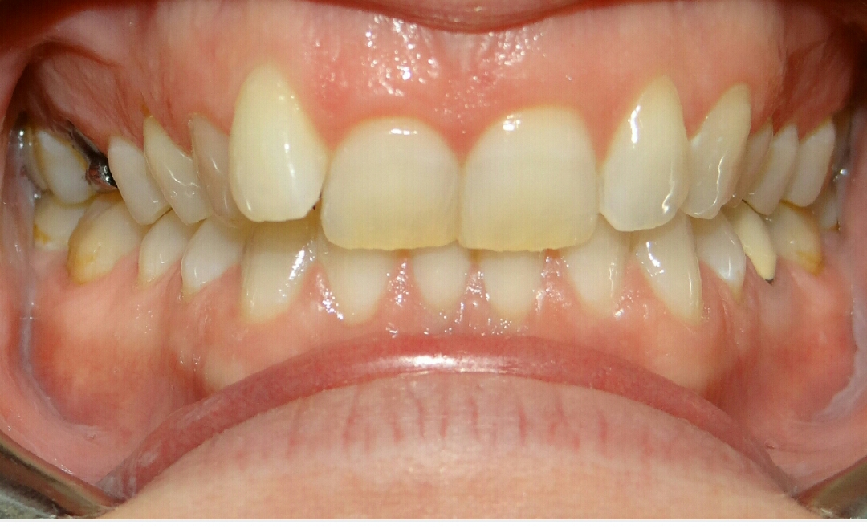
Vertical plane malocclusions
Deep bite
Excessive vertical overlap between upper and lower anteriors

Slide 9
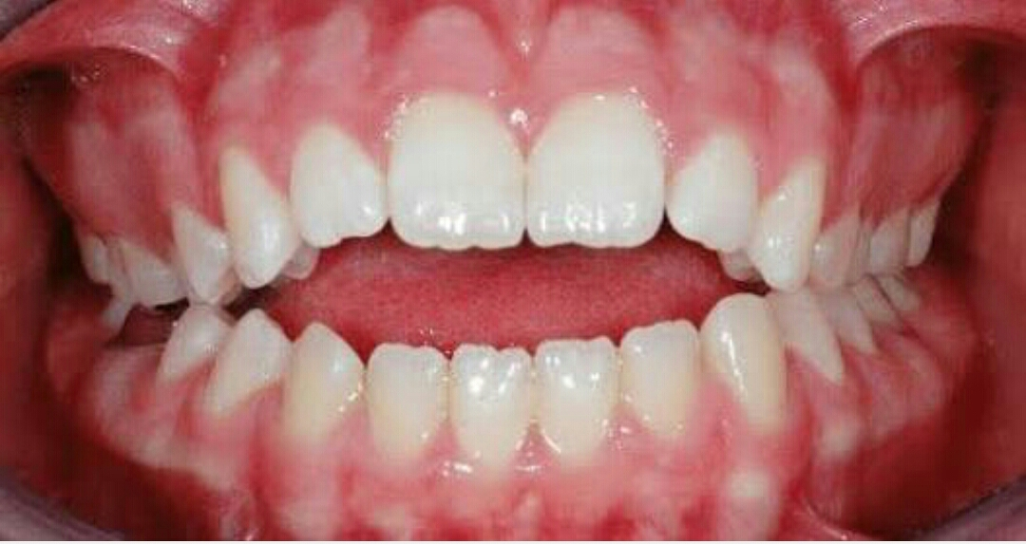
Open bite
No vertical overlap and thus space between upper and lower in centric occlusion

Slide 10
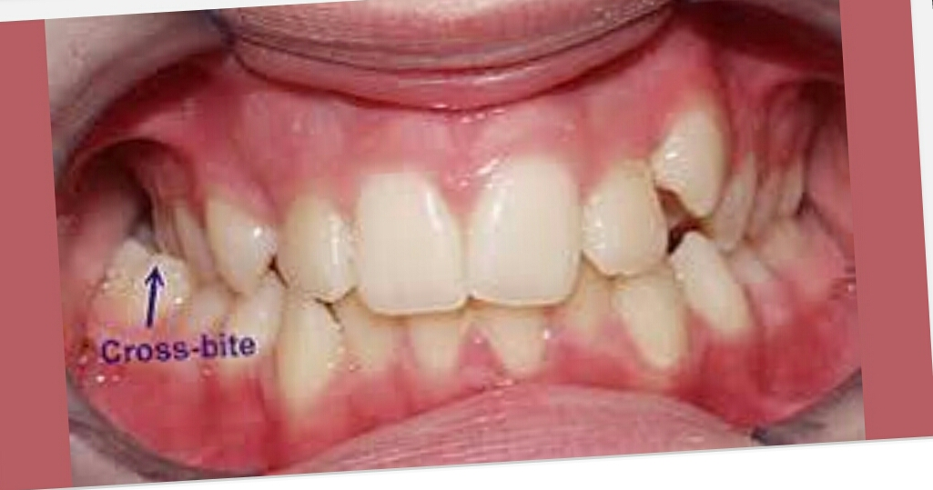
Transverse plane
CROSSBITE refers to abnormal tranverse relationship between upper and lower arches.

Slide 11
Skeletal malocclusion
Malocclusion due to abnormalities in maxilla or mandible.
Occurs in 3 planes of spaces;Sagital,Vertical and Transverse

Slide 12
Angle’s system of classification
Edward Angle in 1899
Angle’s classification is based on mesio-distal relation of teeth ,dental arches and jaws.
According to Angle,the 1st max molar is the key to occlusion
ANGLE’S CLASS I
The mesiobuccal cusp of max 1st permanent molar occludes in the buccal grove of mand 1st permanent molar

Slide 13
ANGLE’S CLASS II
The disto-buccal cusp of the upper 1st permanent molar occludes in the buccal groove of the lower 1st permanent molar.

Slide 15
CLASS II ,DIV 1
CLASS II,DIV 2
Proclined upper incisors
Increase in overjet
Deep incisor overbite
Convex profile
Short ,incompetent lips
V shaped arch form
Deep palate
Increased mentalis and bucccinator
Normal path of closure
Normal or increased lower facial height
Malar process is not prominent
Lingually inclined central incisors ,labially tipped upper lateral incisors overlapping the central incisors
Decreased overjet
Straight or slightly convex
Normal lips
U shaped arch form
Normal palate depth
Normal muscle activity
Backward path of closure
Decreased lower facial height
Prominent malar process

Slide 16
CLASS II ,SUBDIVISION
When a class II molar relation on one side and classI on other side
CLASS III MALOCCLUSION
Mesiobuccal cusp of maxillary 1st permanent molar occluding in the interdental space between the mand 1st and 2nd molar
TRUE CLASS III
Excessively large mandible
Forwardly placed mandible
Smaller than normal maxilla
Retropositioned maxilla
Combination of all the above

Slide 17
PSEUDO CLASS III
The malocclusion produced due to the forward movement of mandible during jaw closure, also called postural or habitual class III malocclusion
Causes
Presence of occlusal prematurities
Premature loss of deciduous posteriors
Enlarged adenoids
CLASS III ,SUBDIVISION
Characterised by class I on one side and class II on other

Slide 18
Drawbacks of Angle’s classification
It disregarded the relationship of the teeth to the face.
Malocclusion is a three-dimensional problem, but Angle considers only sagittal dimension
The position of the maxillary frst permanent molar is not stable as stated by Angle
Etiology of the malocclusion is not known.
Skeletal problems are not given consideration .
The classifcation is not applicable when frst permanent molars are missing.
It is not applicable in deciduous dentition

Slide 19
Dewey’s Modifcation of Angle’s Classifcation
MODIFICATIONS OF ANGLES CLASS I
Type 1 -Angles Class I with crowded maxillary anterior teeth
Type 2-Angles Class I with maxillary incisors in labio-version (proclined) Dewey in 1915 modified Angle’s Class I and Class III by segregating malpositions of anterior and posterior segments
Type 3-Angle’s Class I with maxillary incisor teeth in linguoversion to mandibular incisor teeth (anteriors in cross bite)

Slide 20
Dewey’s Modifcation of Angle’s Classifcation
MODIFICATIONS OF ANGLES CLASS I
Type 4-Molars and/or premolars are in bucco or linguoversion, but incisors and canines are in normal alignment (posteriors in cross bite)
Type 5-Molars are in mesio-version due to early loss of teeth mesial to them (early loss of deciduous molars or second premolar)

Slide 21
DEWEY’S MODIFICATION OF ANGLE’S CLASS III
Type 1-Individual arches when viewed individually are in normal alignment, but when in occlusion the anteriors are in edge to edge bite
Type 2-The mandibular incisors are crowded and lingual to the maxillary incisors
Type 3-Maxillary arch is underdeveloped, in cross bite with maxillary incisors crowded and the mandibular arch is well developed and well aligned

Slide 22
SIMON’S CLASSIFICATION OF MALOCCLUSION
Simon in 1930 was the first to relate the dental arches to the face and cranium in the three planes of space, i.e.
• Frankfort horizontal (vertically)
• Orbital plane (anteroposteriorly)
• Raphe or median sagittal plane (transverse)

Slide 23
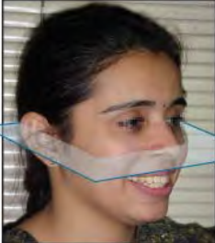
SIMON’S CLASSIFICATION OF MALOCCLUSION
FRANKFORT HORIZONTAL (VERTICALLY)
Frankfort horizontal plane (F-H Plane) or the eye-ear plane (E-EP) is determined by drawing a straight line through the margins of the bony orbit directly under the pupil of the eye to the upper margins of the external auditory meatus (the notch above the tragus of the ear).

Slide 24
SIMON’S CLASSIFICATION OF MALOCCLUSION
FRANKFORT HORIZONTAL (VERTICALLY)
This plane is used to classify malocclusions in the vertical plane. Vertical deviations with respect to the plane are: 1. Attractions When the dental arch or part of it is closer to the Frankfort horizontal plane it is referred to as attraction. 2. Abstractions When a dental arch or a part of it is further away from the Frankfort horizontal plane, it is referred to as abstraction.

Slide 25
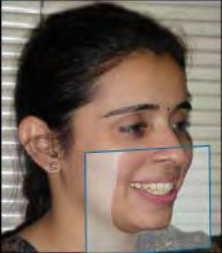
ORBITAL PLANE (ANTERO-POSTERIORLY)
Malocclusions described as anterior-posterior deviations based on their distance from the orbital plane are-

Slide 26
ORBITAL PLANE (ANTERO-POSTERIORLY)
Protraction The teeth, one or both, dental arches, and/or jaws are too far forward, i.e. placed forward or anterior to the plane as compared to the normal; where the plane passes through the distal incline of the canine.
Retraction The teeth one or both dental arches and/ or jaws are too far backward, i.e. placed posterior to the plane than normal.

Slide 27
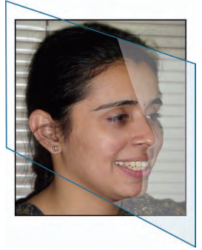
RAPHE OR MEDIAN SAGITTAL PLANE
Malocclusions classified according to transverse deviations from the median sagittal plane are:

Slide 28
RAPHE OR MEDIAN SAGITTAL PLANE
1. Contraction A part or all of the dental arch is contracted towards the median sagittal plane.
2. Distraction A part or all of the dental arch is wider or placed at a distance which is more than normal.

Slide 29
ACKERMAN-PROFITT SYSTEM OF CLASSIFICATION

Slide 30
INCISOR CLASSIFICATION
CLASS I-The mandibular incisor edges occlude with or lie immediately below the cingulum plateau of the maxillary central incisors
CLASS II-The mandibular incisor edges lie posterior to the cingulum plateau of the maxillary central incisors.
Division 1 The maxillary central incisors are proclined or of average inclination and there is an increased overjet
Division 2 The maxillary central incisors are retro-clined; the overjet is normally minimum, but may be increase

Slide 31
INCISOR CLASSIFICATION
CLASS III-The mandibular incisor edges lie anterior to the cingulum plateau of the upper central incisors; the overjet is reduced or reversed

Slide 32
SUMMARY

Slide 33
REFERENCES
Textbook of Orthodontics – Gurkeerat Singh, Jaypee Brothers; 2nd Edition
Orthodontics – The Art and Science, S.I Bhalajhi, AryaMedi Publishing; 7th Edition
Textbook of Orthodontics – Sridhar Premkumar, Elsevier; 1st Edition
Orthodontics: Diagnosis and Management of Malocclusion and Dentofacial Deformities – O.P Kharbanda, Elsevier; 1st Edition

Slide 34
SUMMARY

Slide 35
REFERENCES
Textbook of Orthodontics – Gurkeerat Singh, Jaypee Brothers; 2nd Edition
Orthodontics – The Art and Science, S.I Bhalajhi, AryaMedi Publishing; 7th Edition
Textbook of Orthodontics – Sridhar Premkumar, Elsevier; 1st Edition
Orthodontics: Diagnosis and Management of Malocclusion and Dentofacial Deformities – O.P Kharbanda, Elsevier; 1st Edition

Slide 36
Question & Answer Session

